Slide 1

CM3070 Pitch
Physics-based game
Notes:
For my final project I will be using the Physics-based game template

Slide 2
Boardgames
Notes:
My proposed game design will be based on simulating a tabletop board game. Boardgaming is an area that holds especial interest for me, as a structure around which to base social engagements, and for the mental – and occasionally physical – challenges such games provide.

Slide 3
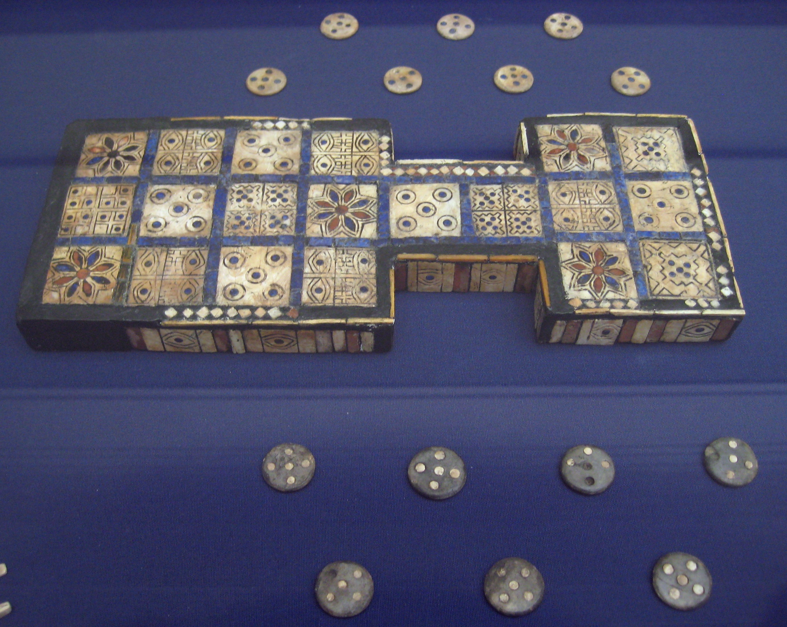
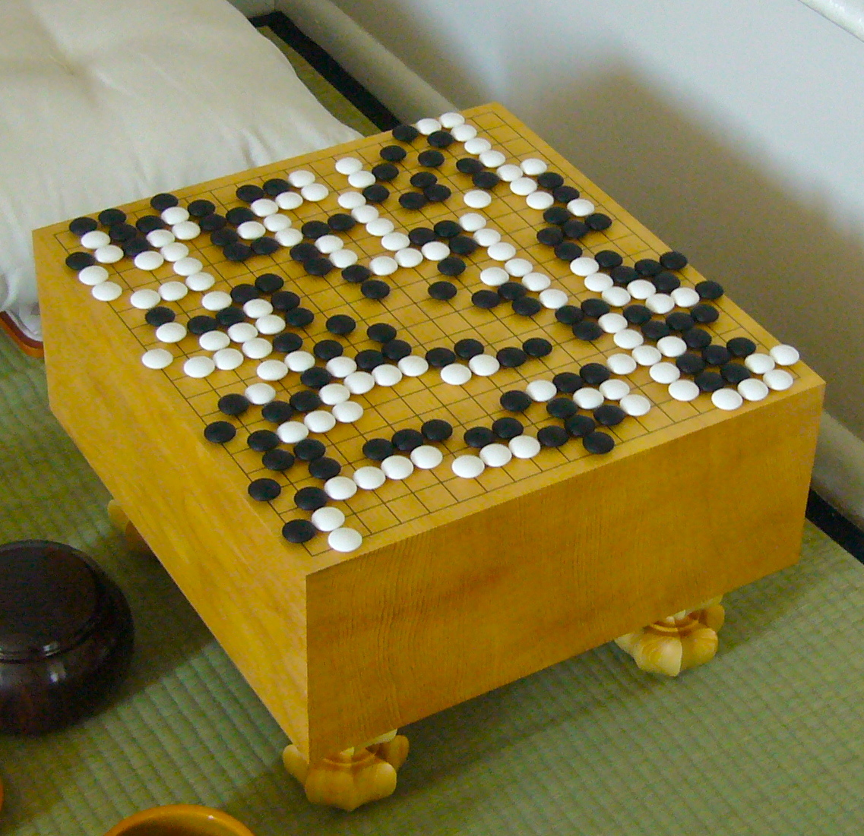
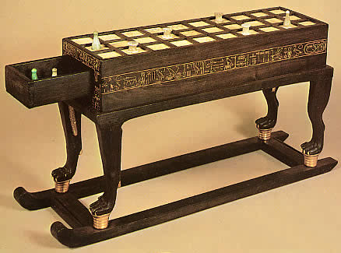
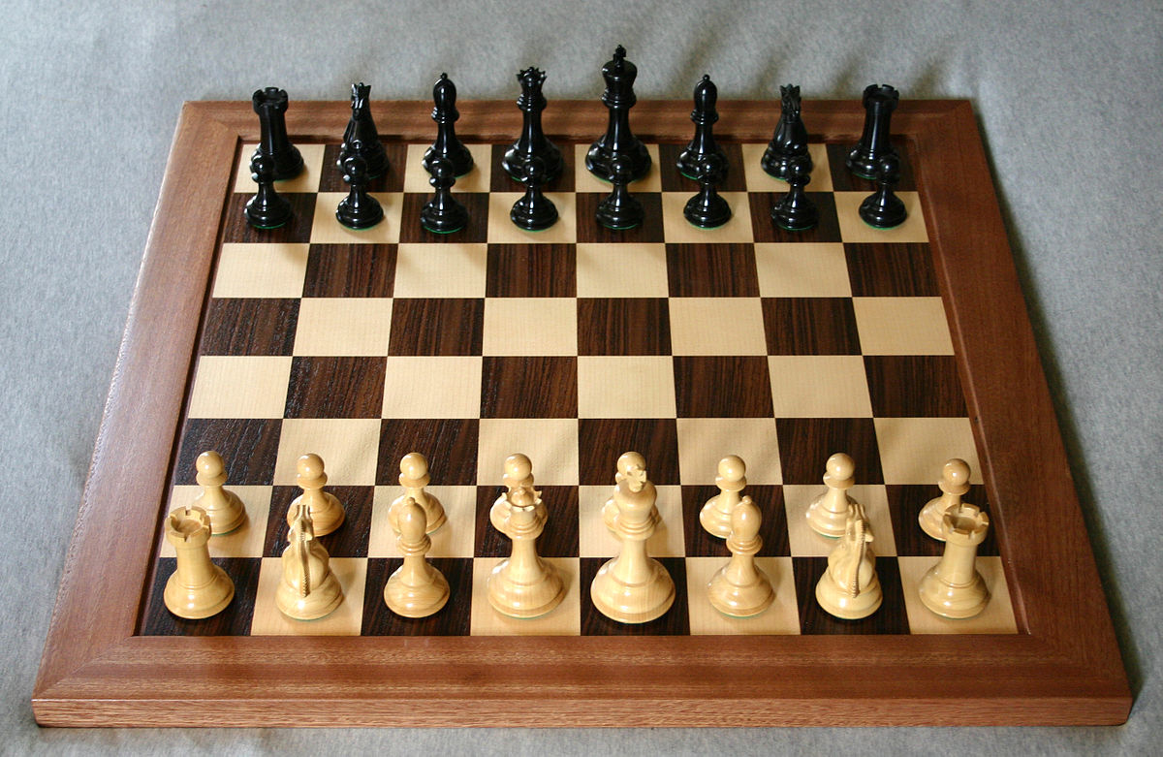
Boardgames
Royal Game of Ur: c.2600 BCE, Mesopotamia
Go: c.4000 BCE, China
Senet: c.2600 BCE, Egypt
Chess: c.1475 CE, Europe
P. Shotwell, “Some New Approaches to the Study of the History of Go in Ancient China and Siberia”, in The 2nd International Conference on Baduk: proceedings, Seoul, 2003.
M. Sebbane, “Board Games from Canaan in the Early and Intermediate Bronze Ages and the Origin of the Egyptian Senet Game”, Tel Aviv, vol. 28, no. 2, pp. 213-230, 2013.
H. Davidson, A Short History of Chess, New York: David McKay Company, 1949. C. L. Wooley, Ur Excavations Volume II: The Royal Cemetery, London: Publications of the Joint Expeditions of the British Museum and the Museum of the University of Pennsylvania, 1934.
Notes:
Humans have been playing boardgames for thousands of years and throughout the world. Archaeological examples exist from ancient cultures, and records show the evolution and propagation of games throughout history.

Slide 4
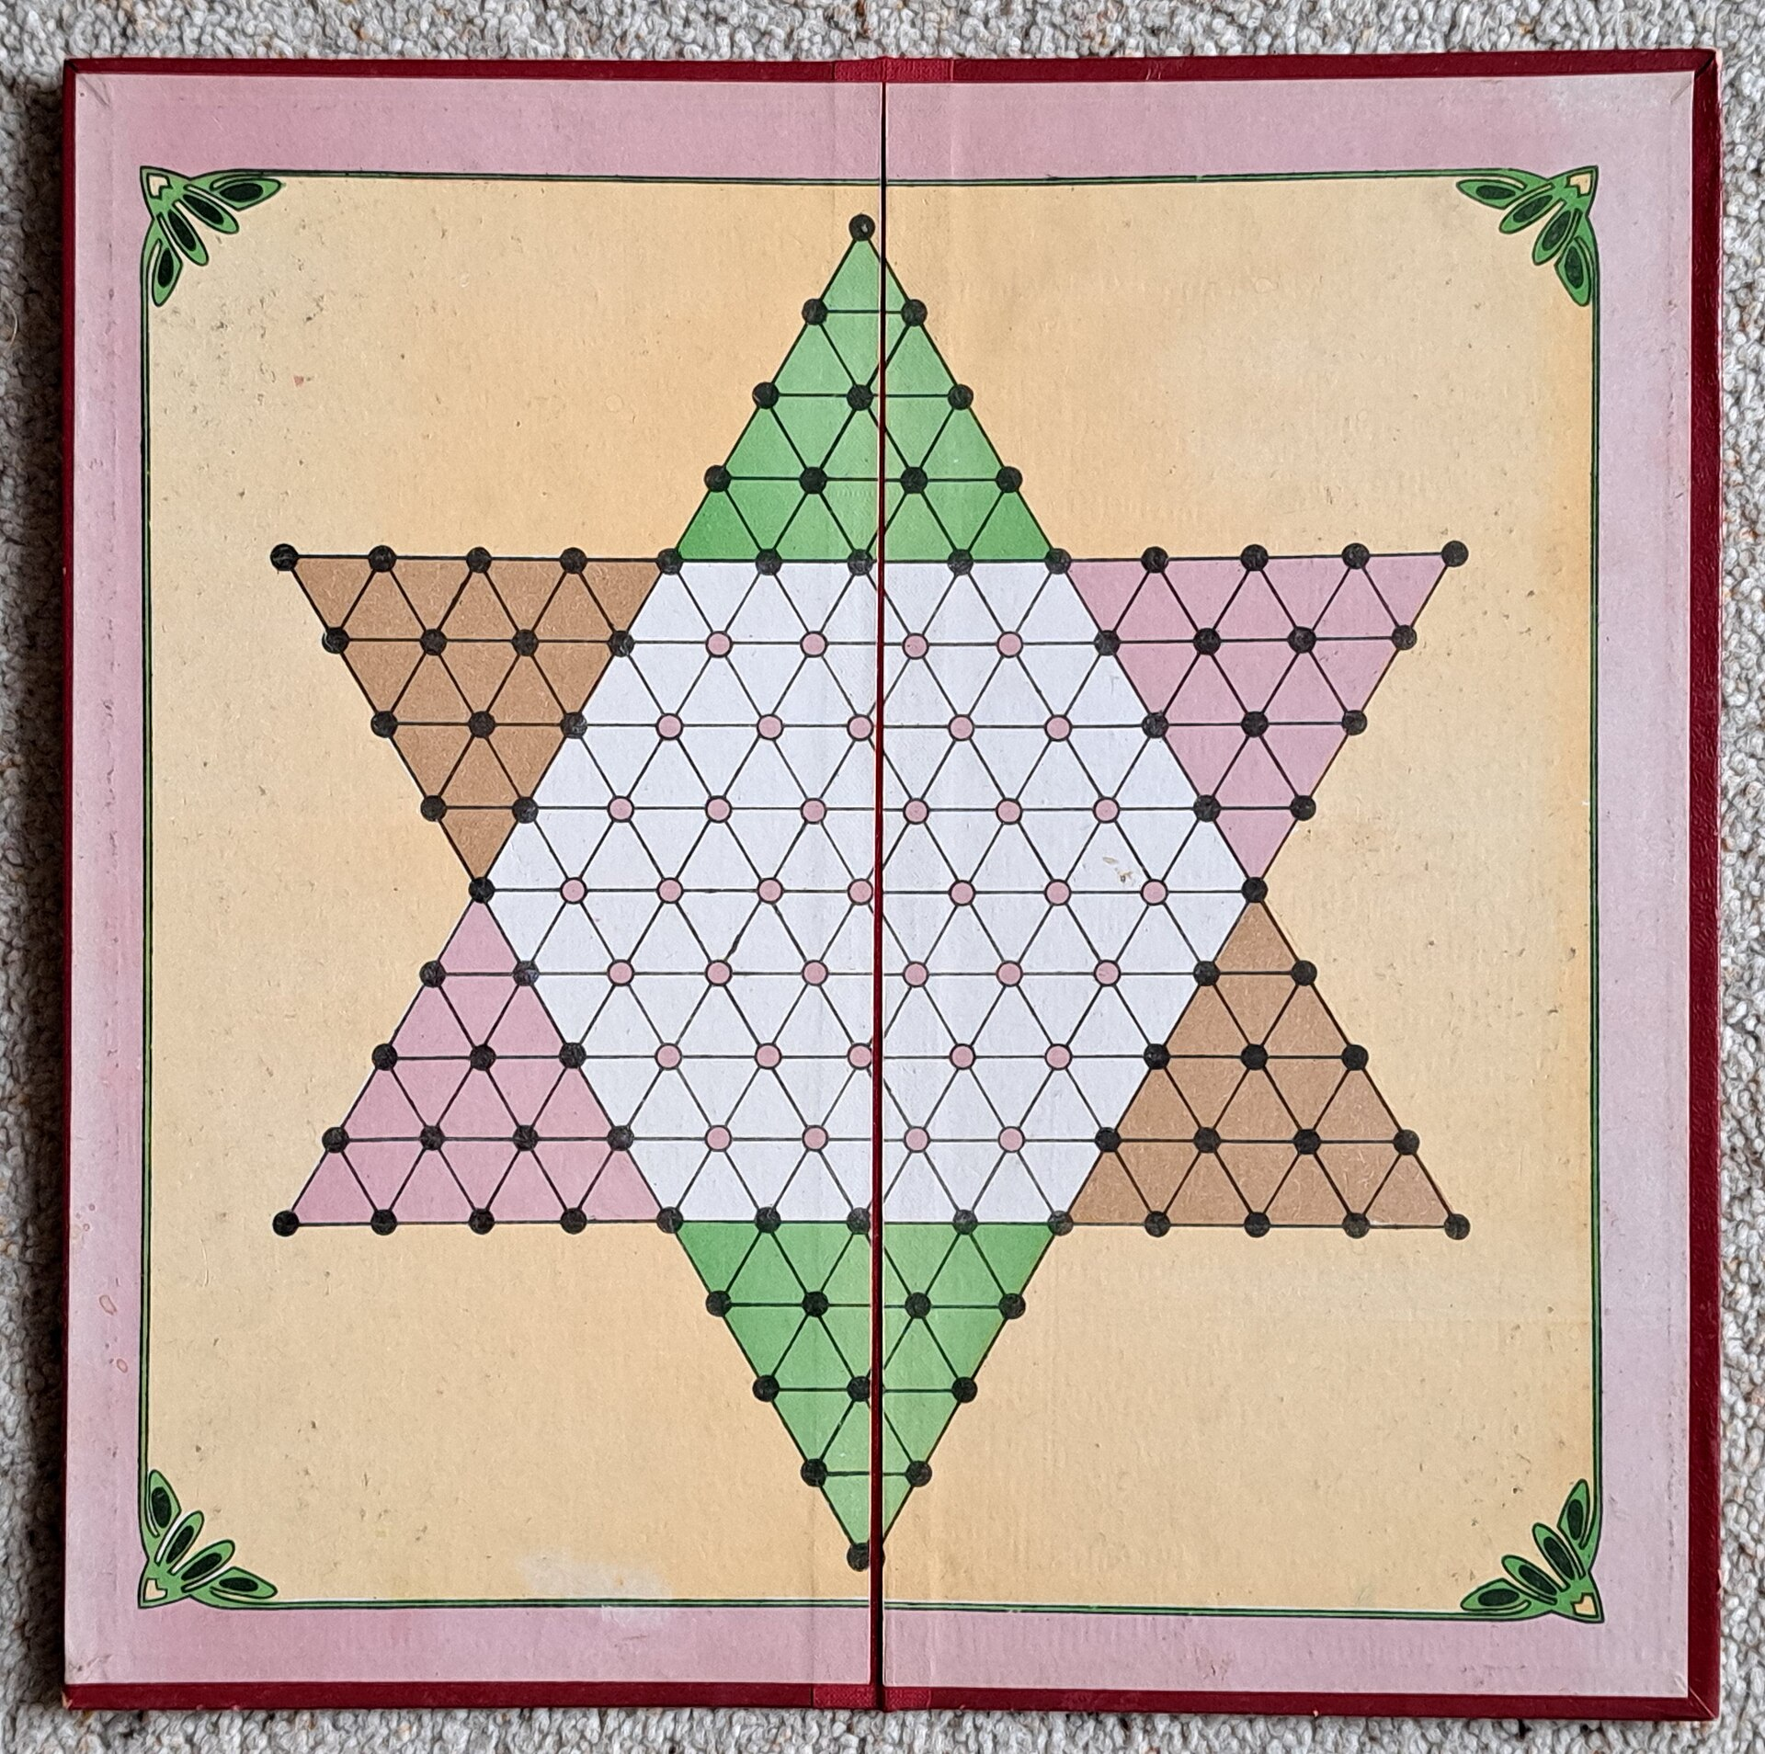
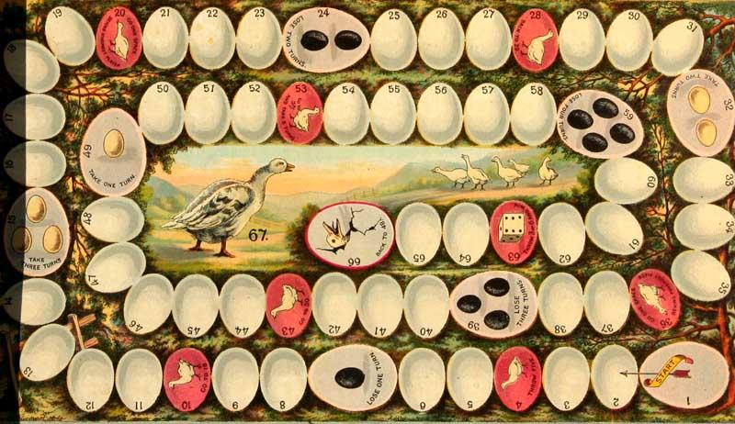
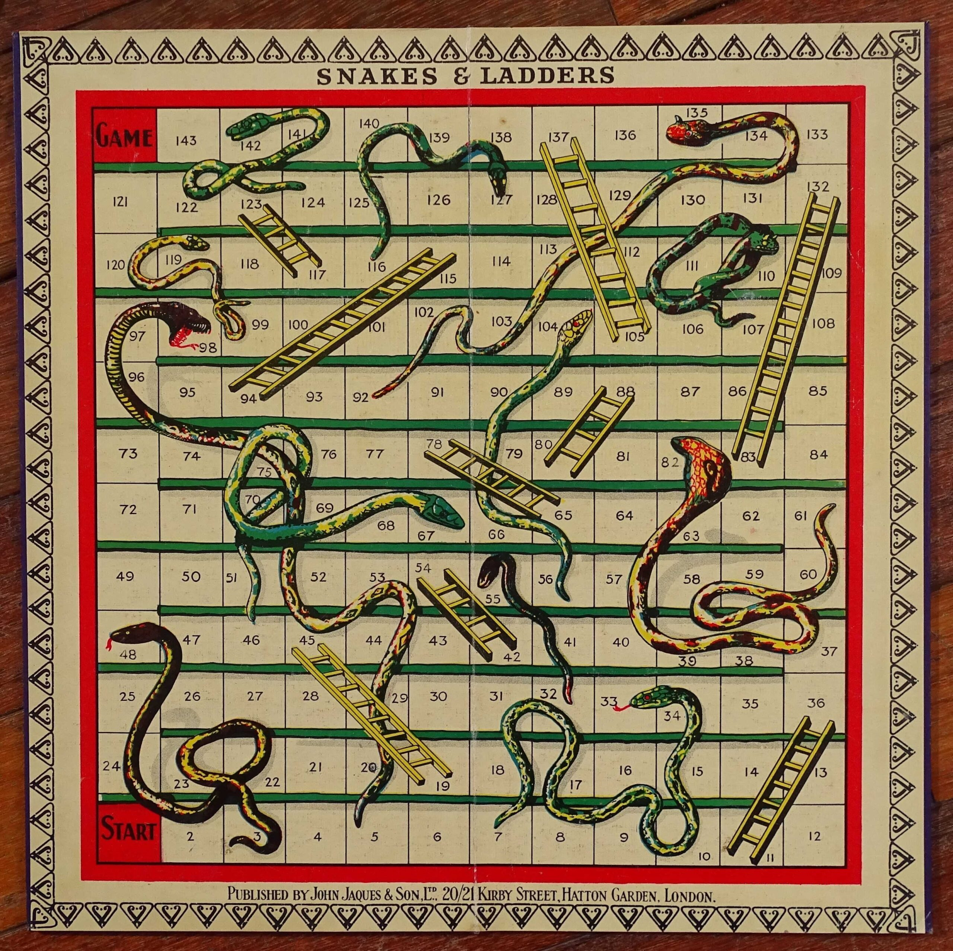
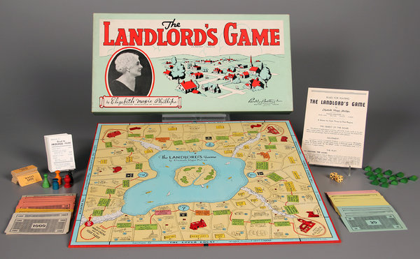
Boardgames
Halma (Chinese Checkers), 1883
The Game of the Goose, c.1880
The Landlord’s Game, 1904
Snakes & Ladders, 1890
M. Hofer, The Games We Played: The Golden Age of Board & Table Games, New York: Princeton Architectural Press, 2003.
Notes:
The late 19th and early 20th centuries are considered the first ‘Golden Age’ of board games. With the advent of commercial production, the variety and proliferation of these games dramatically increased.

Slide 5
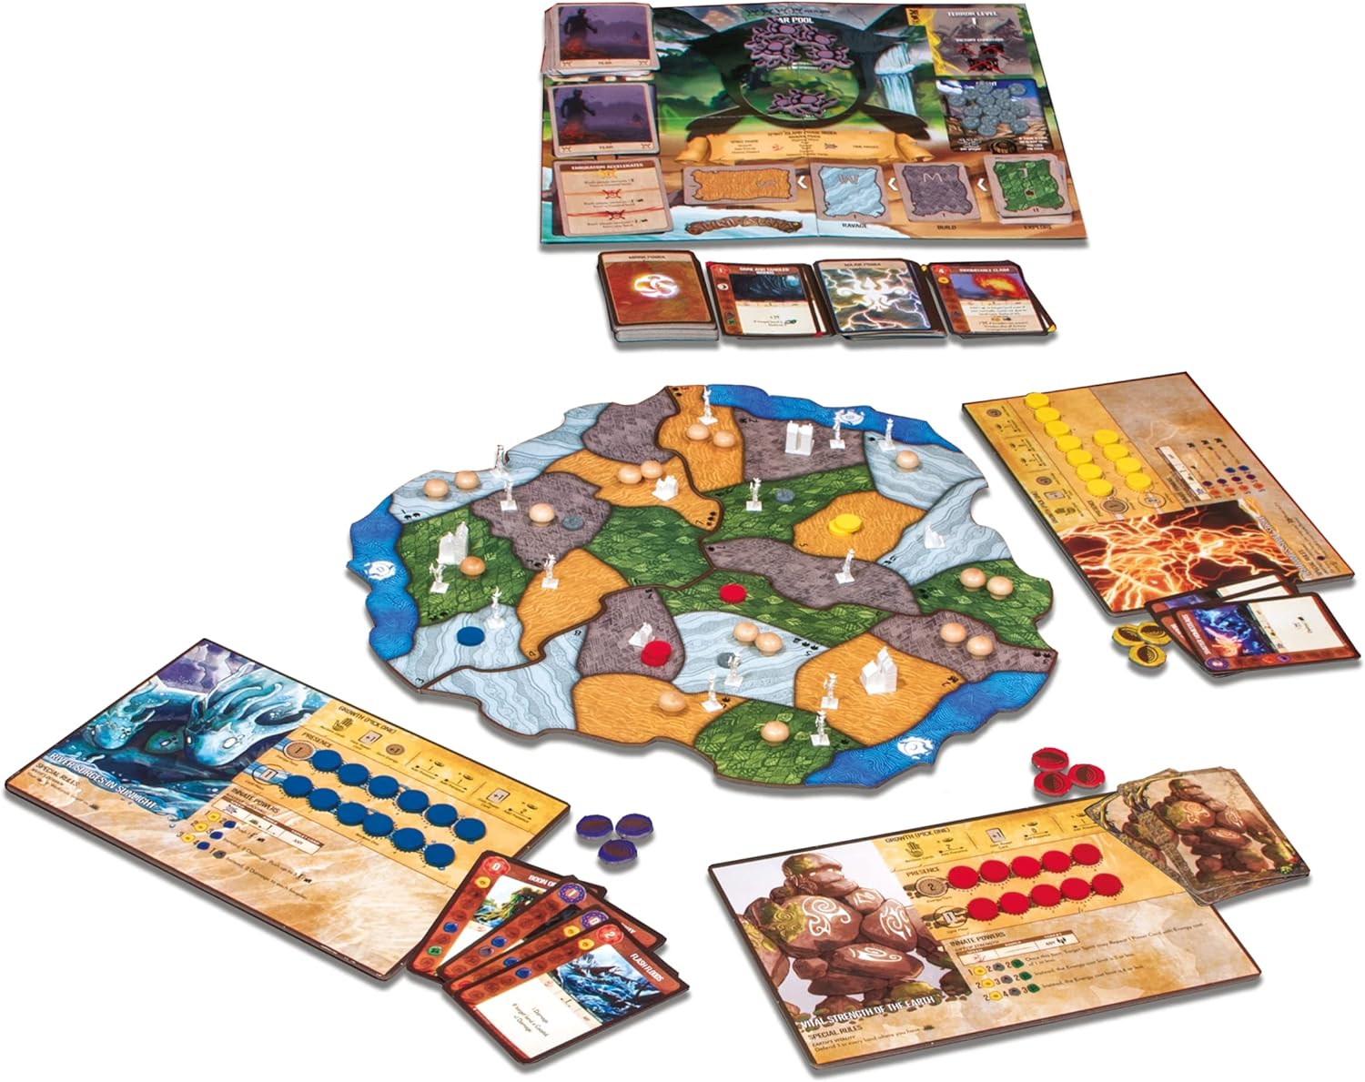
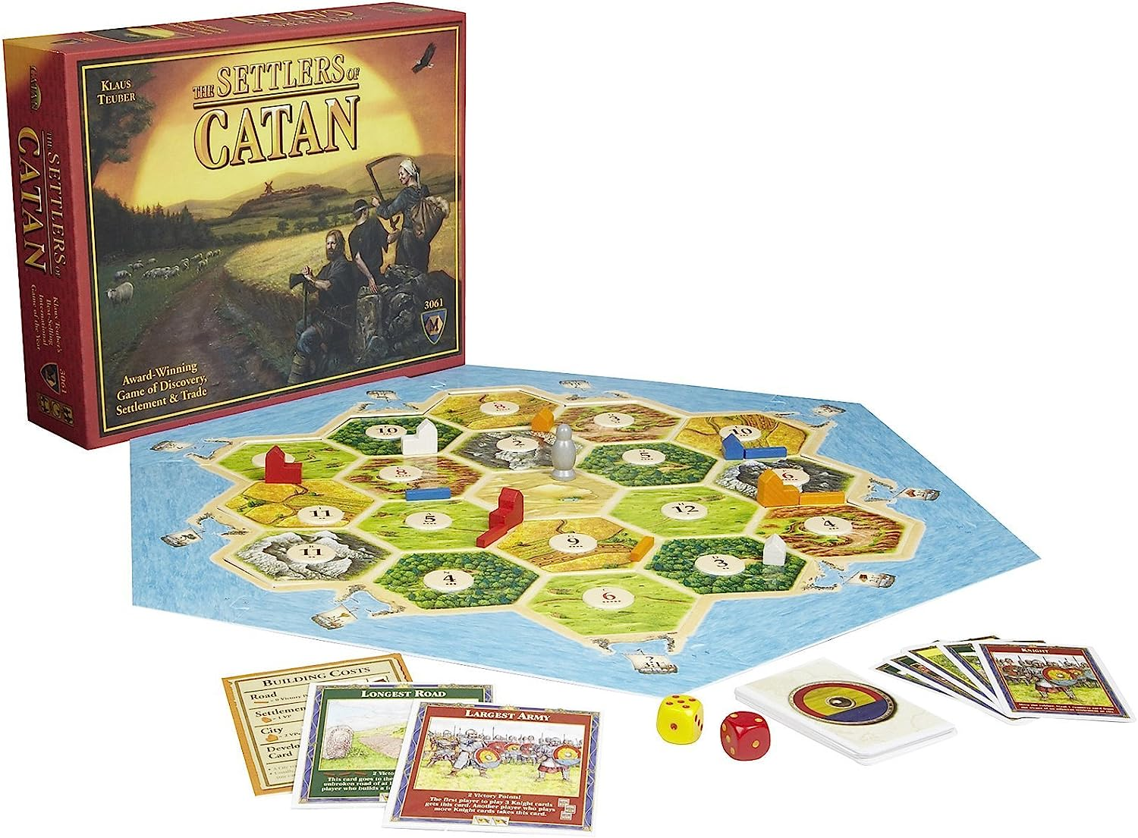
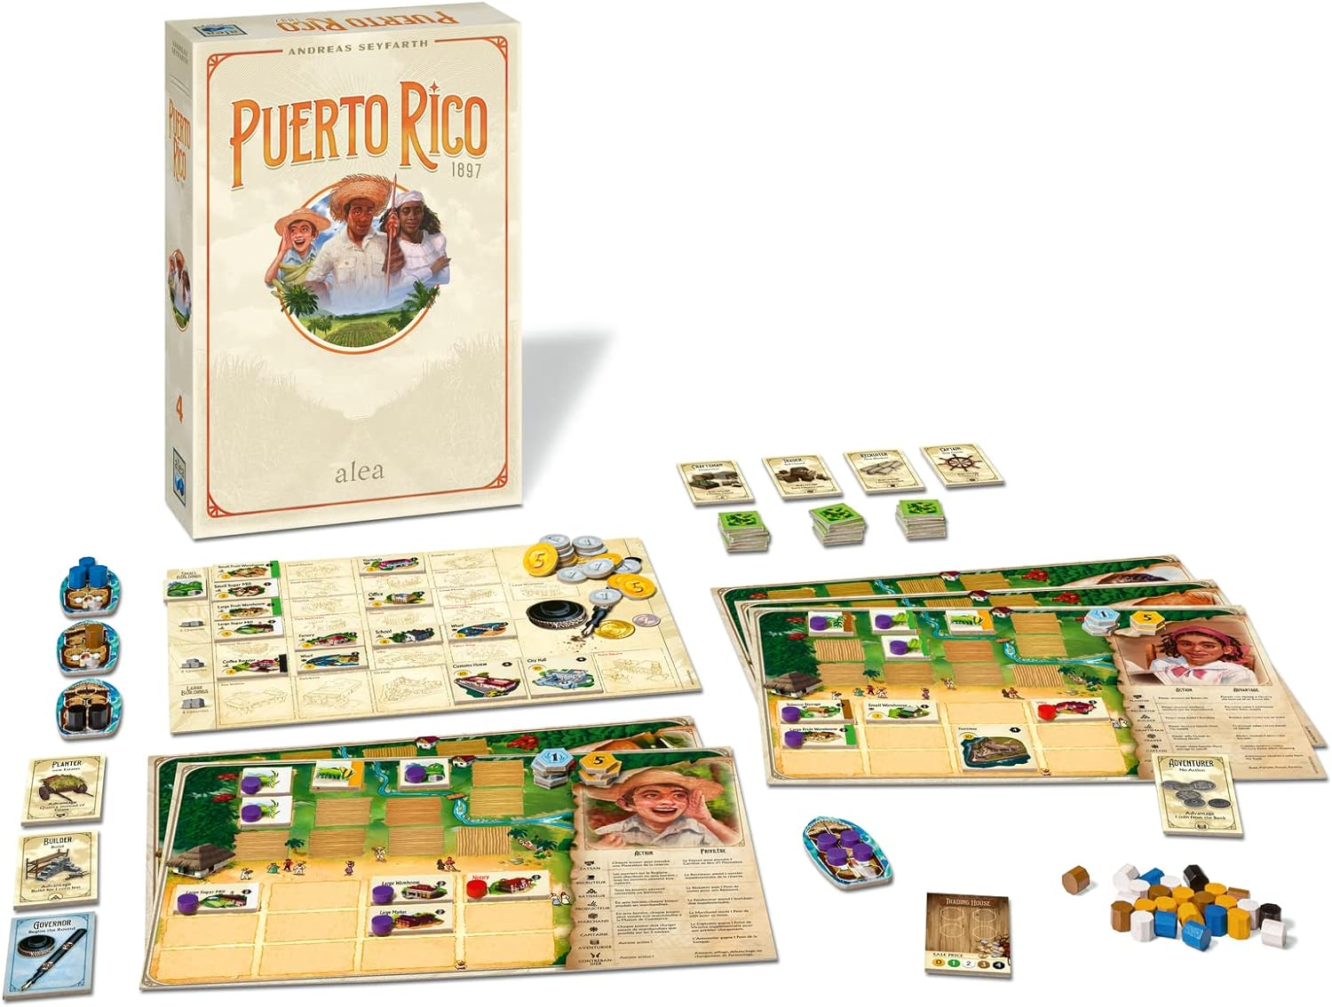
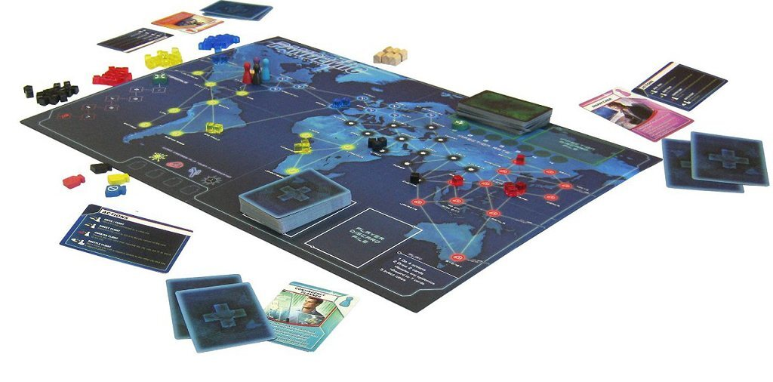
Boardgames
Spirit Island, 2017
The Settlers of Catan, 1995
Puerto Rico, 2002
Pandemic, 2008
A. Curry, “Monopoly Killer: Perfect German Board Game Redefines Genre”, Condé Nast, 23 03 2009. [Online]. Available: https://www.wired.com/2009/03/mf-settlers/.
S. Woods, Eurogames: The Design, Culture and Play of Modern European Board Games, Jefferson N.C.: McFarland & Company, 2012.
Notes:
Since the 1990s the so-called “Board game renaissance” has seen a resurgence in the popularity and innovation of modern tabletop gaming.

Slide 6
Dexterity games
Notes:
While boardgames are inherently physical objects, a subset - known as “Dexterity games” - make explicit use of their physicality, and may thus be an appropriate influence for a physics-based computer game.

Slide 7
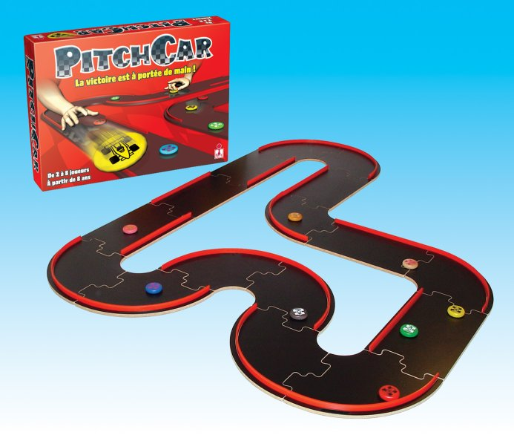
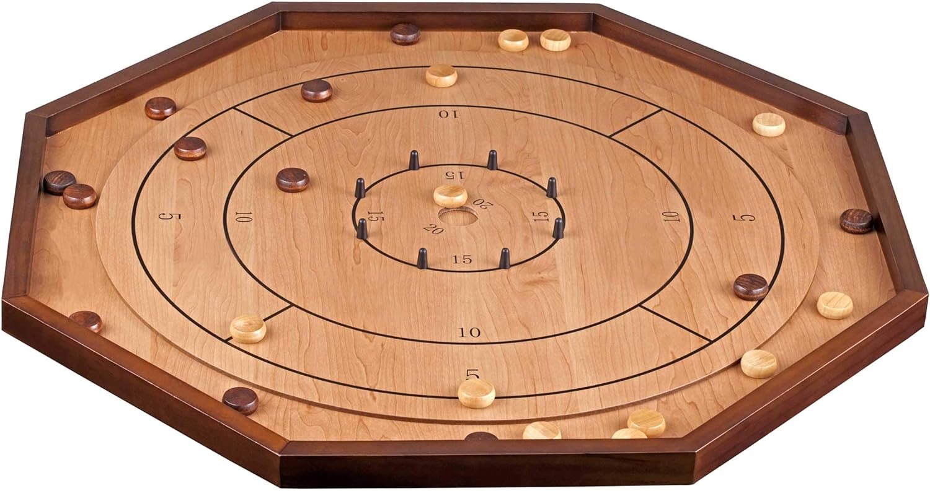
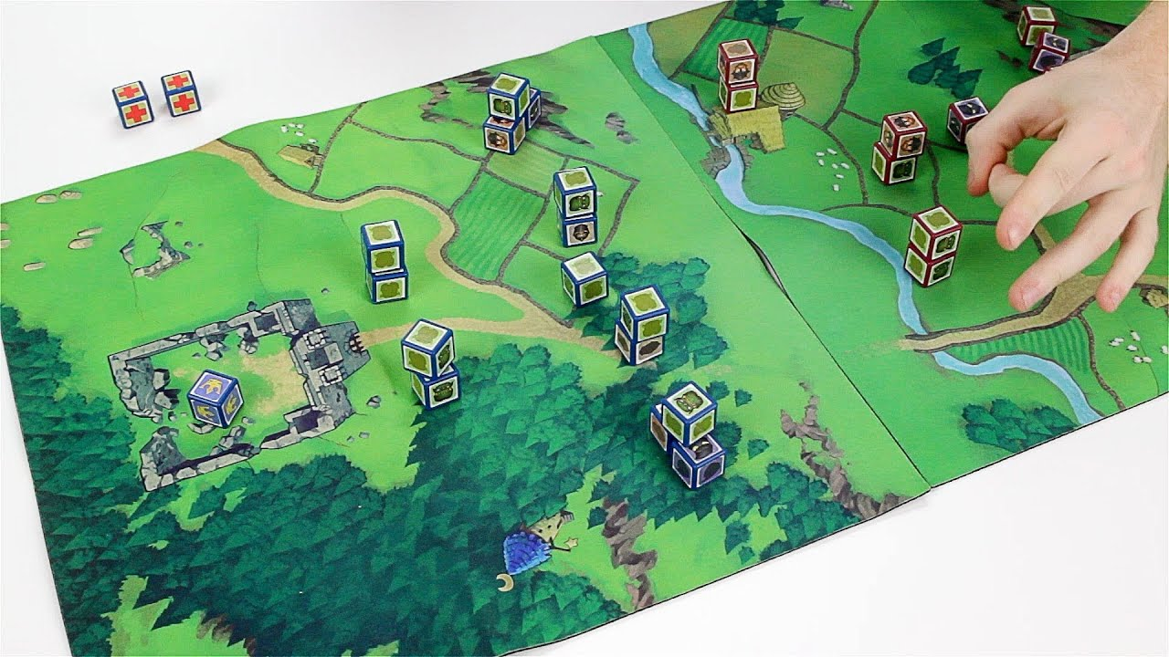
Dexterity games
PitchCar, 1995
Crokinole, 1867
Cube Quest, 2013
N. Howell, Sports and games in Canadian life, 1700 to the present, Toronto: Macmillan of Canada, 1969.
Gamewright, “Cube Quest: Clash for the Crown,” [Online]. Available: https://gamewright.com/product/Cube-Quest. [Accessed 25 10 2023].
Ferti Games, “PitchCar,” [Online]. Available: http://ferti.free.fr/games/pitchcar/index-e.php. [Accessed 25 10 2023].
Notes:
These dexterity games can be divided into three types. Flicking games require the players to accurately maneuverer pieces around the game space, negotiating their interactions with other pieces or obstacles.

Slide 8
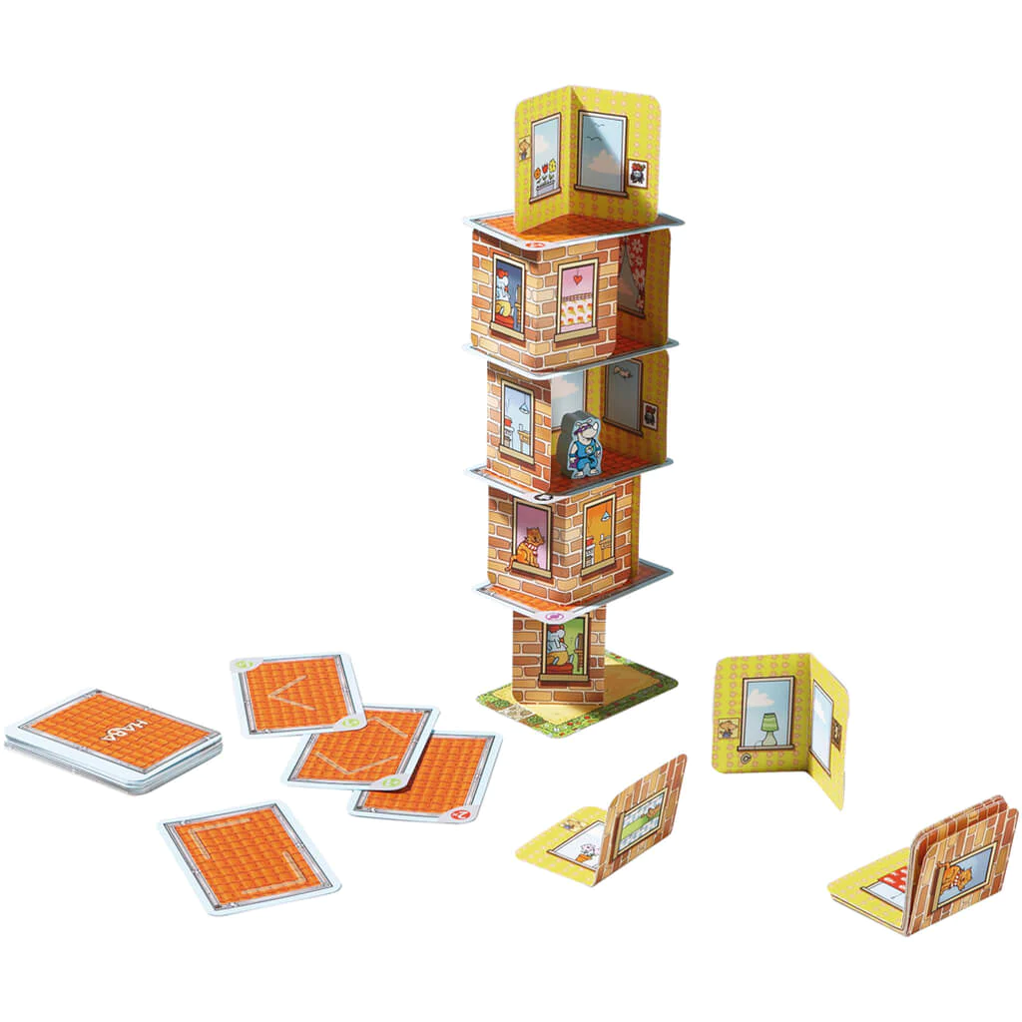
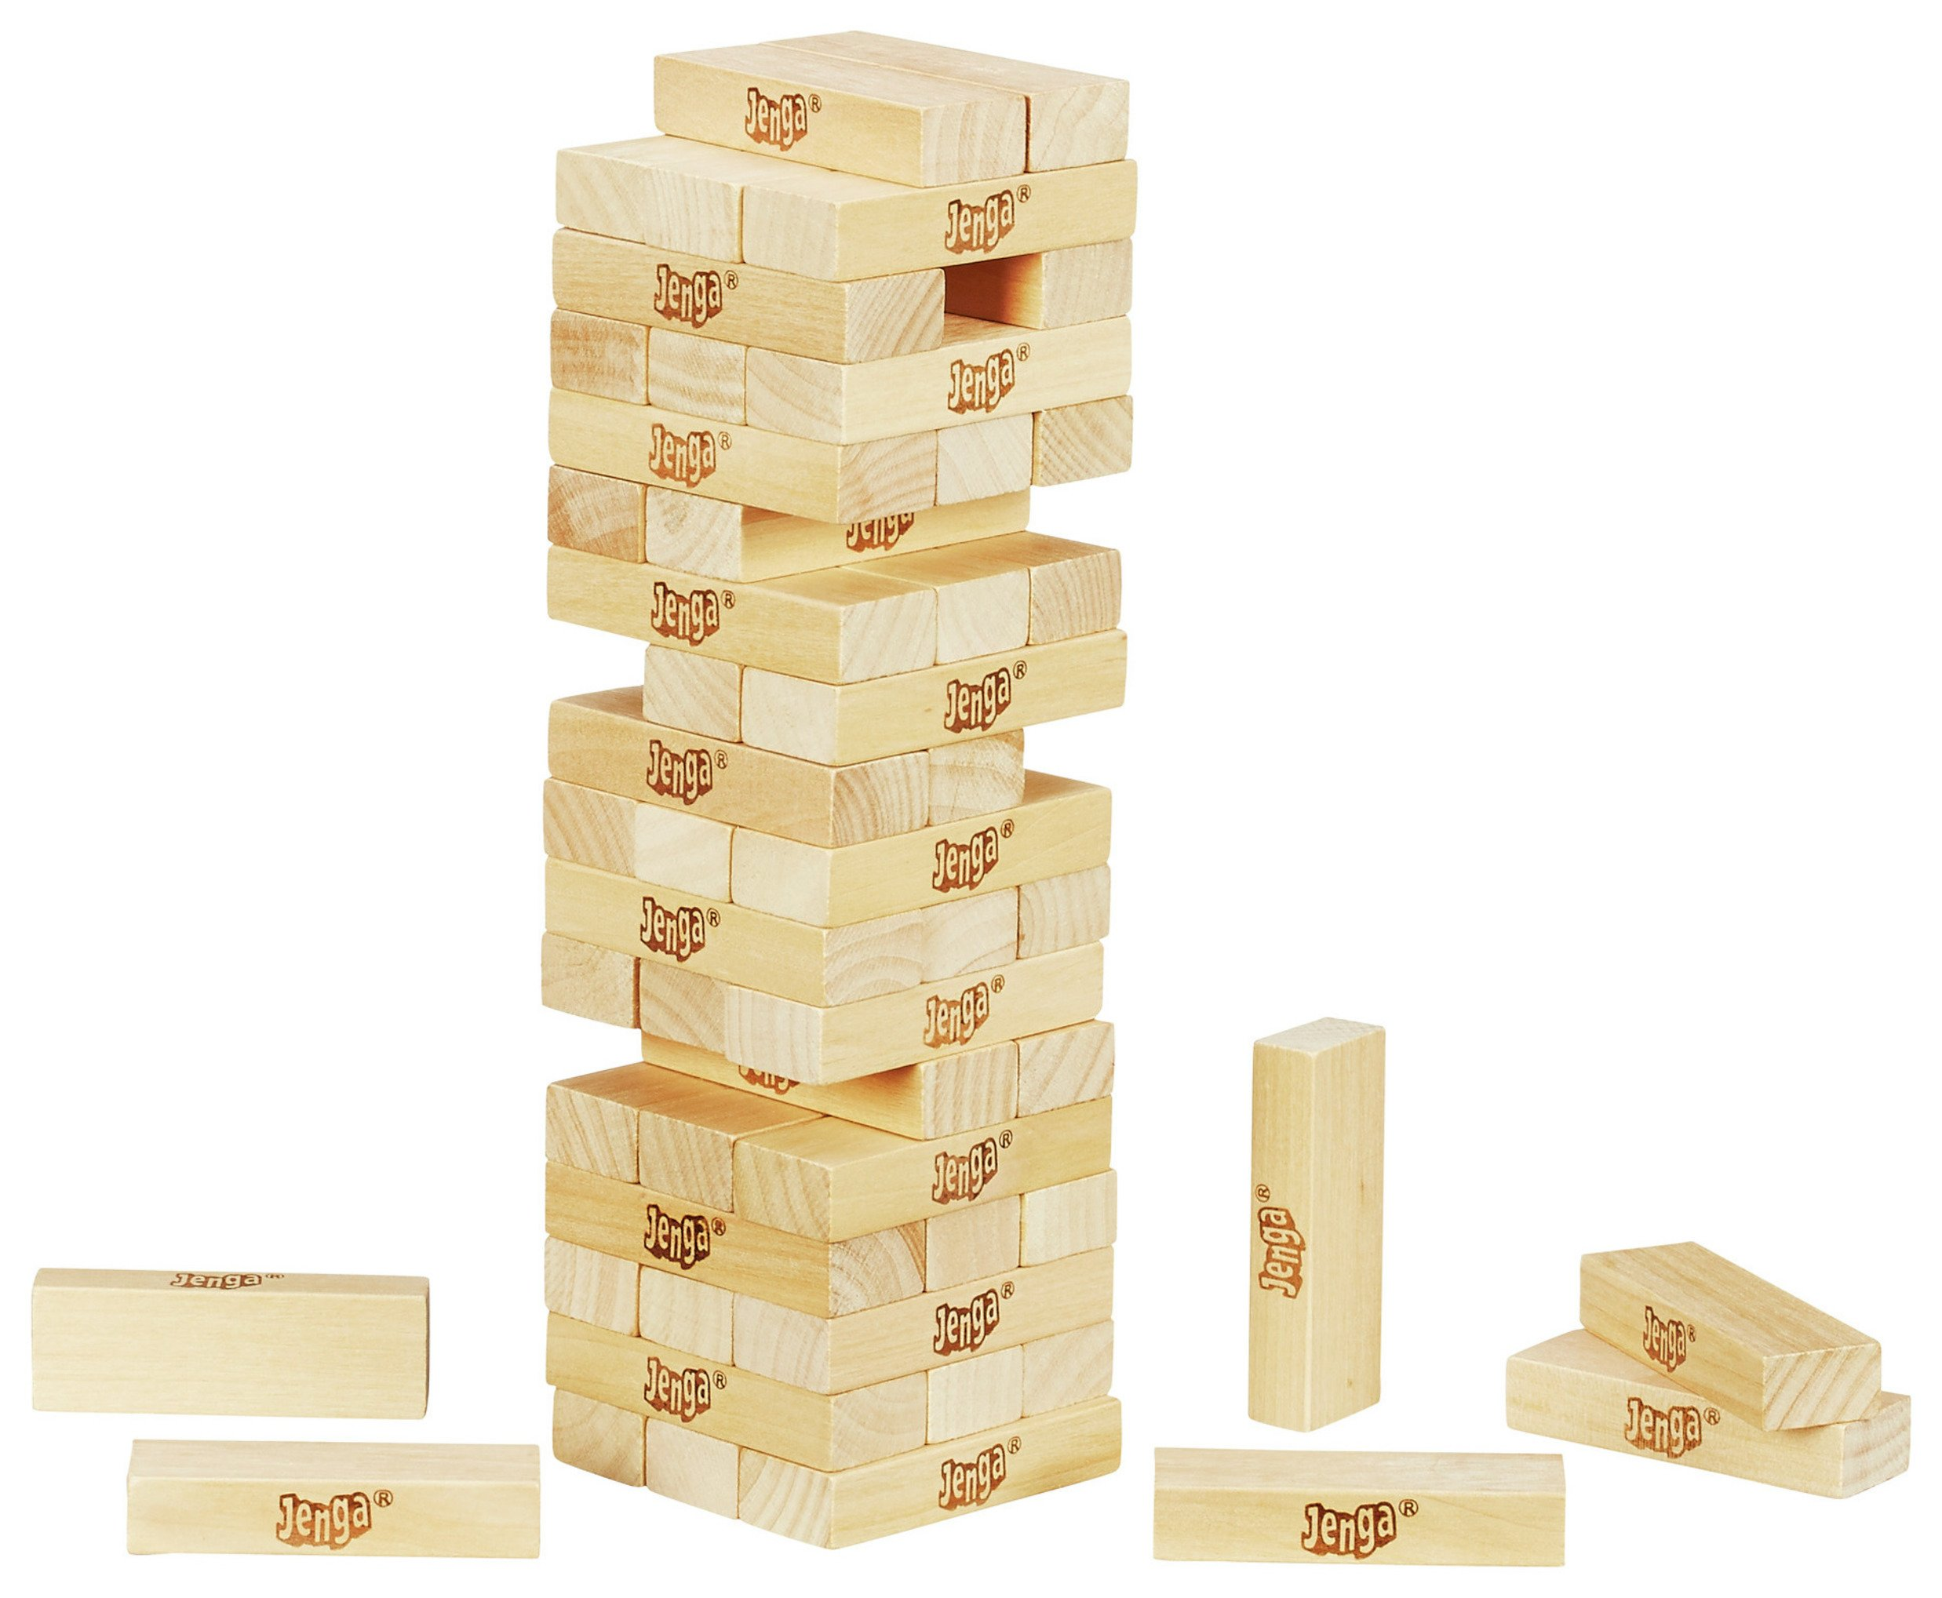
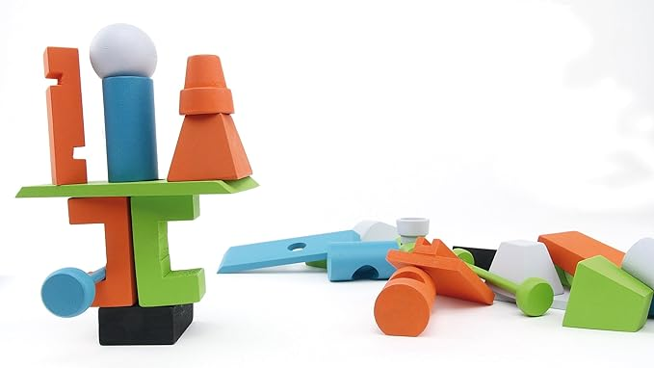
Dexterity games
Rhino Hero, 2011
Jenga, 1983
Junk Art, 2016
T. Walsh, Timeless Toys: Classic Toys And the Playmakers Who Created Them, Kansas City, MO: Andrews McMeel Publishing, 2005.
Asmodee, “Junk Art 3.0,” [Online]. Available: https://www.asmodee.co.uk/products/pbgpzg20030_junk-art-3-0. [Accessed 25 10 2023].
Notes:
Stacking games involve balancing pieces atop each other, generally with the goal of creating the tallest structure, or avoiding a collapse.

Slide 9
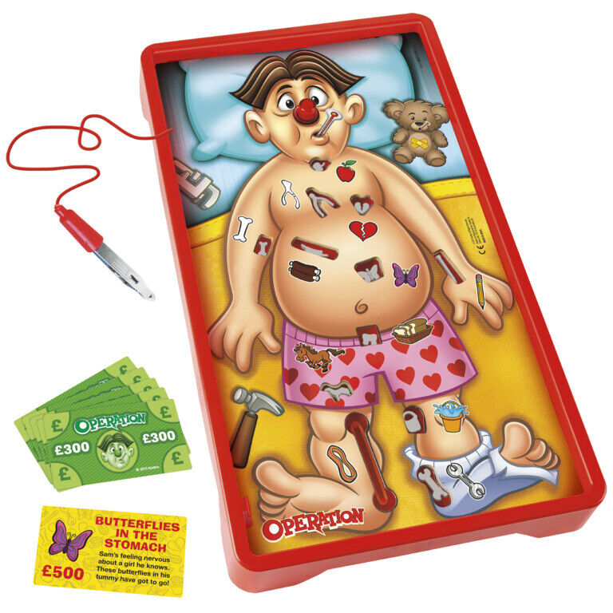
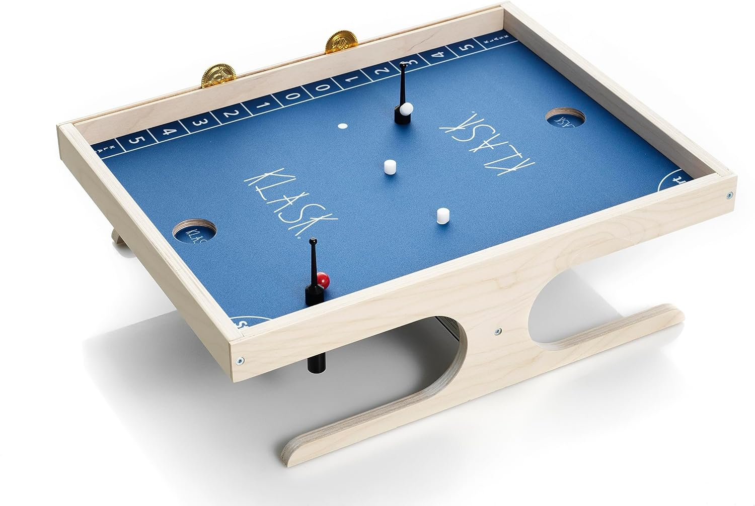
Dexterity games
Operation, 1965
Klask, 2014
Hasbro, “Operation History,” [Online]. Available: https://web.archive.org/web/20110102131609/http://www.hasbro.com/operation/?page=history. [Accessed 25 10 2023].
Oy Marektoy Ltd, “Klask: Our Story,” [Online]. Available: https://www.klaskgame.com/pages/about-us. [Accessed 26 10 2023].
Notes:
Fine control games rely on the players’ hand-eye coordination to perform various precise tasks.

Slide 10
Digital boardgames
Notes:
The resurgence of interest in board games in the last few decades has coincided with the expanding availability and capabilities of home computing devices and the internet. This has led to the development of several digital adaptations of these games.

Slide 11
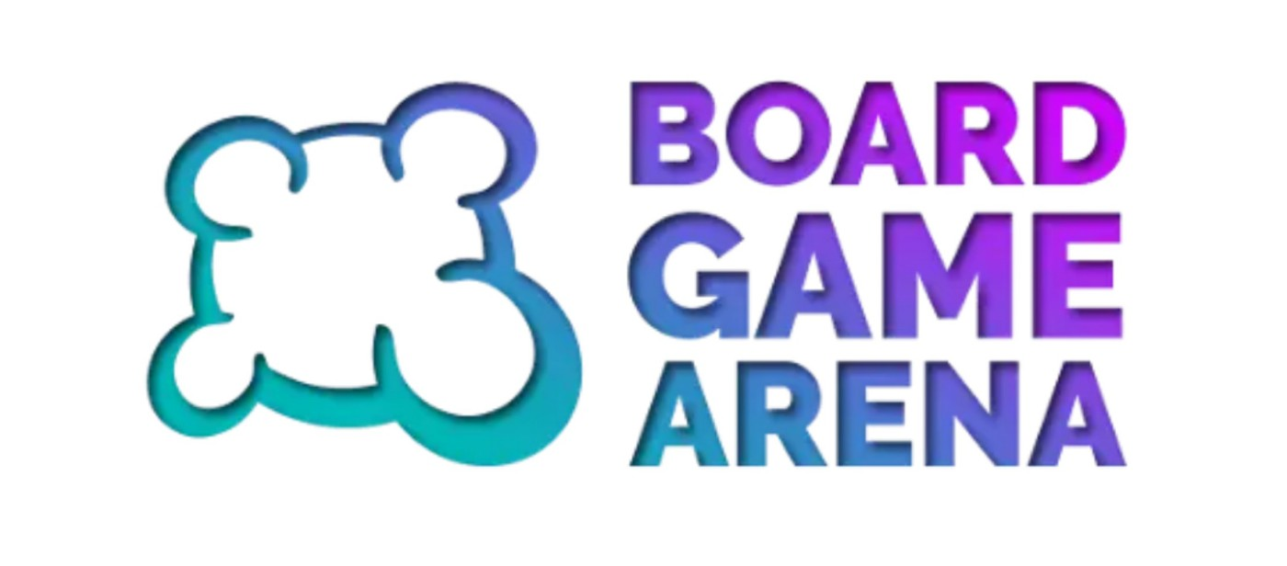
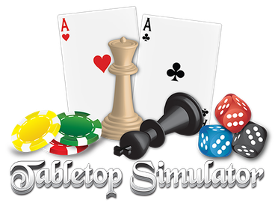
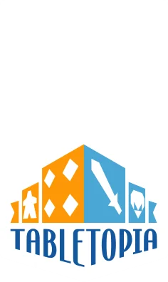
Digital boardgames
AD2G Studio SAS, “Board Game Arena,” [Online]. Available: https://boardgamearena.com/. [Accessed 26 10 2023].
Tabletopia, Inc., “Tabletopia,” [Online]. Available: https://tabletopia.com/. [Accessed 26 10 2023].
Berserk Games LLC, “Tabletop Simulator,” [Online]. Available: https://www.tabletopsimulator.com/. [Accessed 26 10 2023].
Notes:
Services such as Board Game Arena, Tabletopia, and Tabletop Simulator allow players to participate in a variety of games without requiring the physical space for their components, and with access to an internet’s worth of opponents (or team-mates).

Slide 12
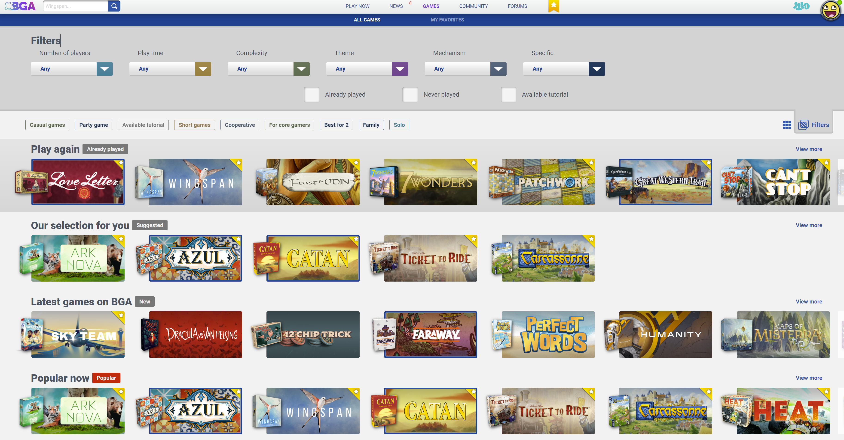
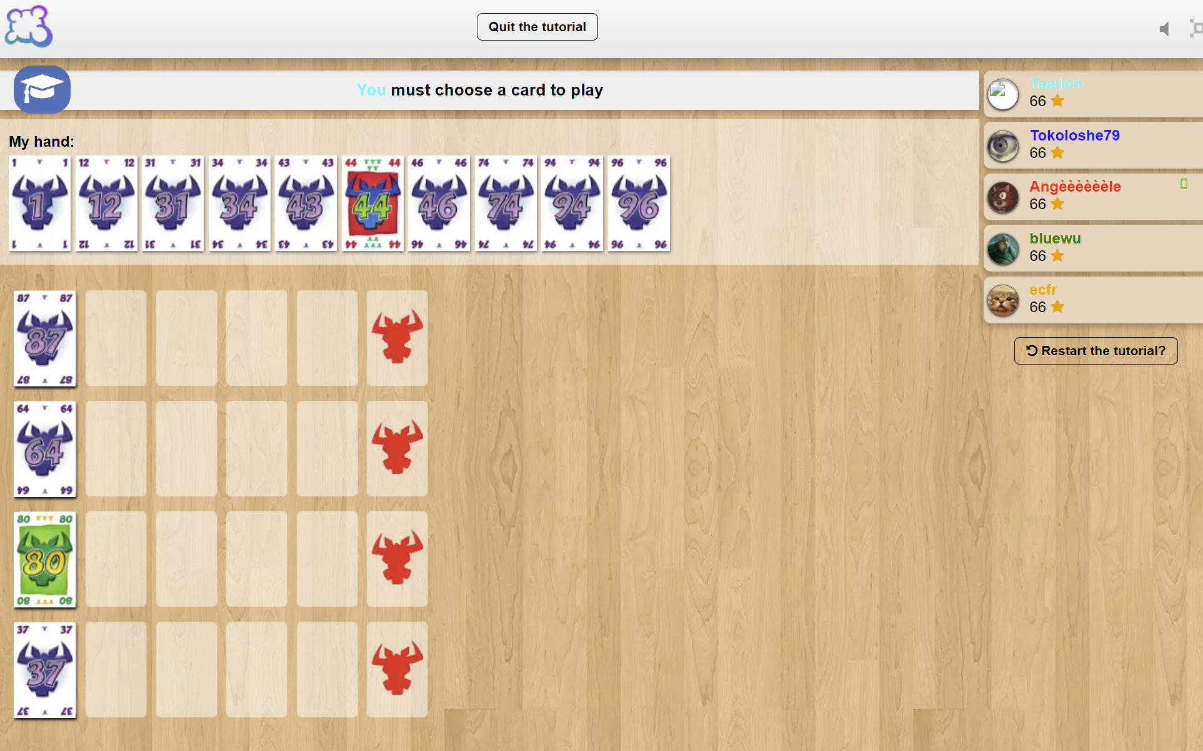
Digital boardgames
AD2G Studio SAS, “What is Board Game Arena?” [Online]. Available: https://boardgamearena.com/join?aboutmode [Accessed 26 10 2023].
Notes:
Tabletopia and Board Game Arena are browser-based services, with subscription models. They host a curated list of licensed games, strongly enforcing their mechanics and rulesets. The game engines used are two-dimensional with no physics simulation, and are thus unsuitable platforms for hosting any type of physics-based dexterity game.

Slide 13
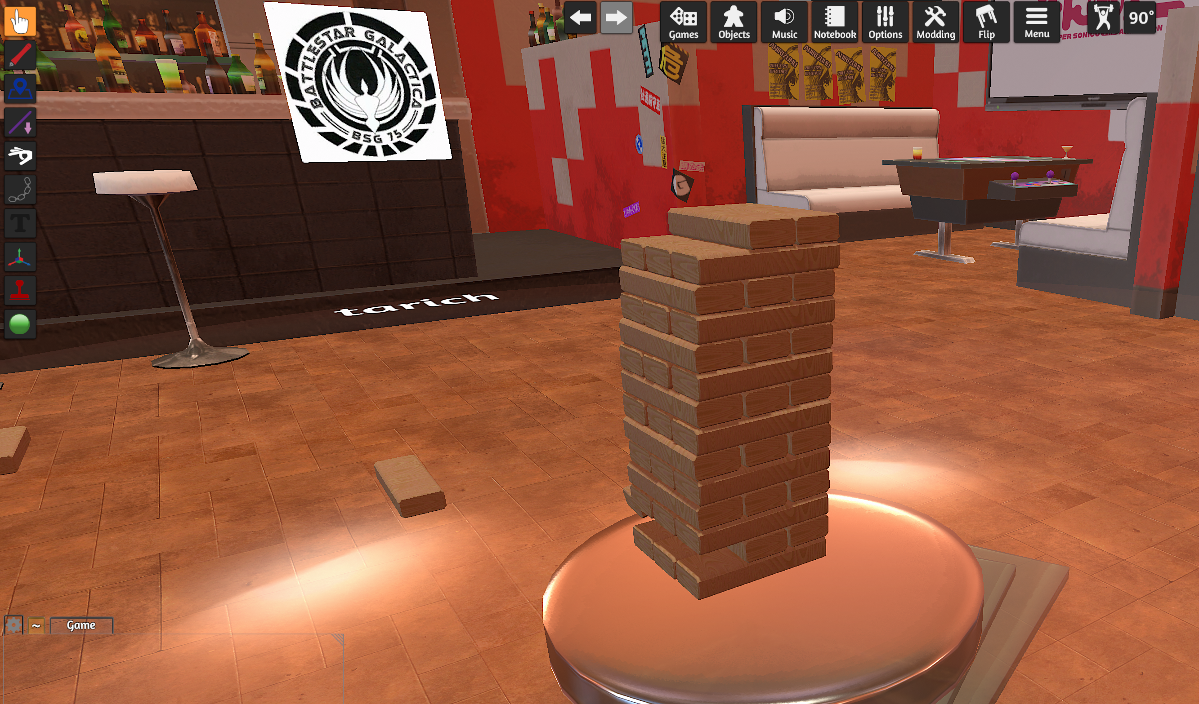
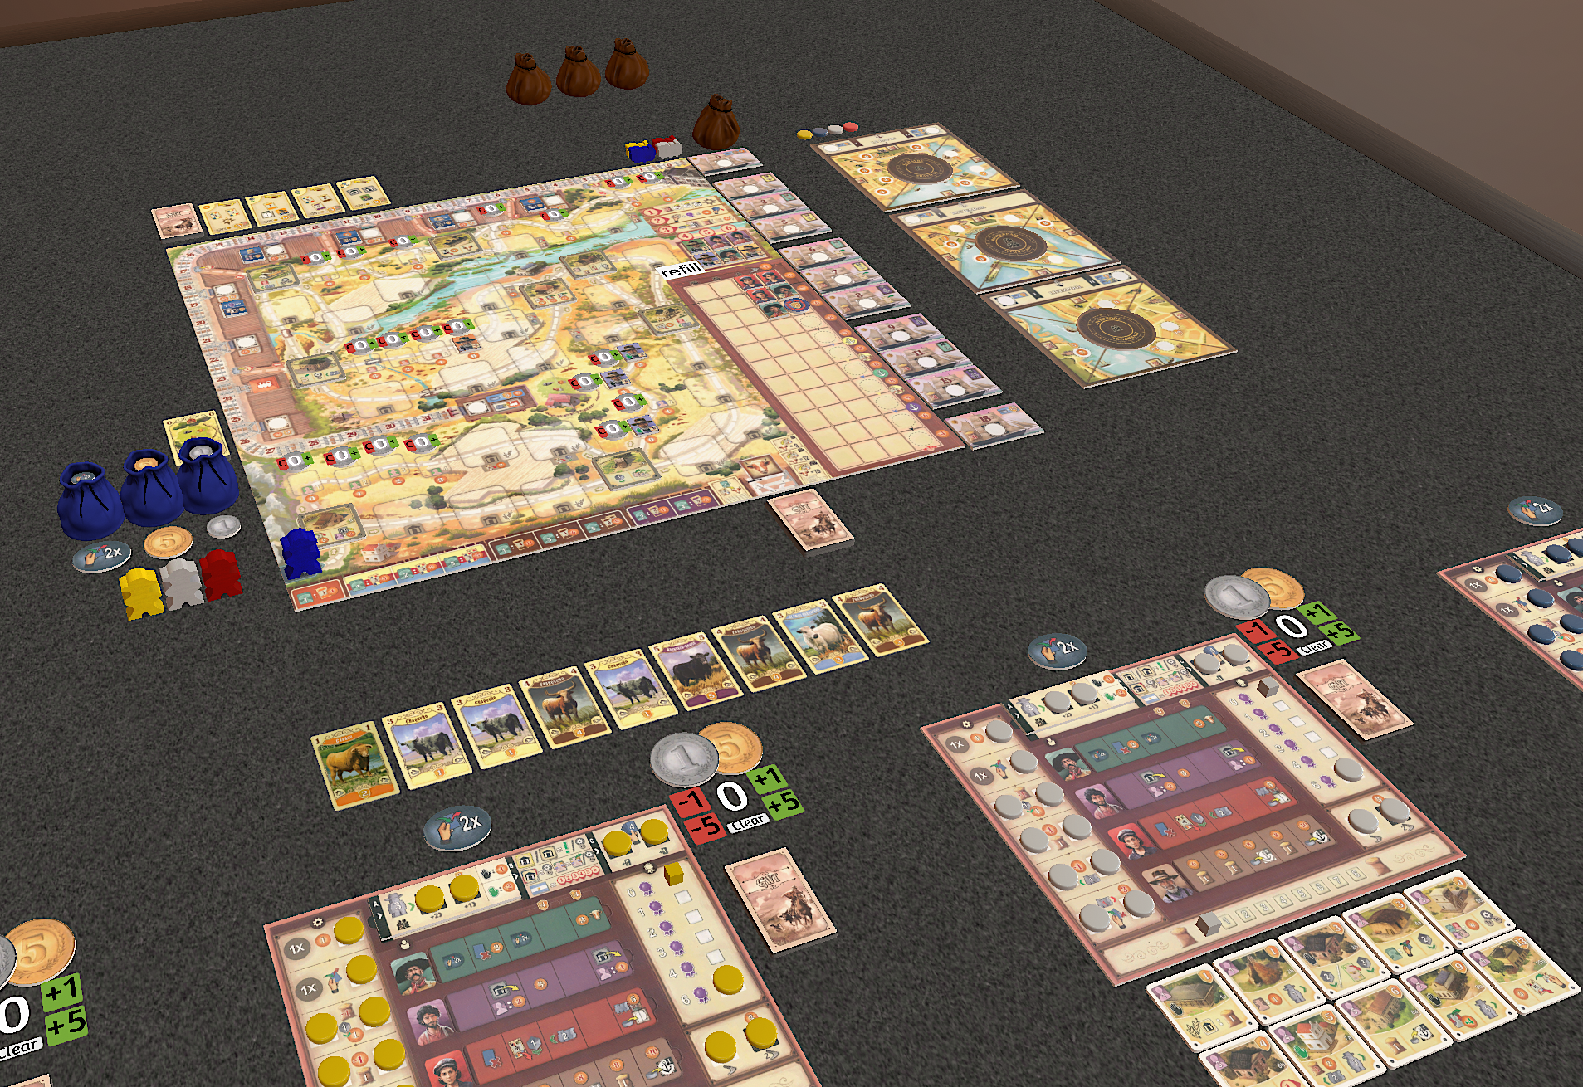
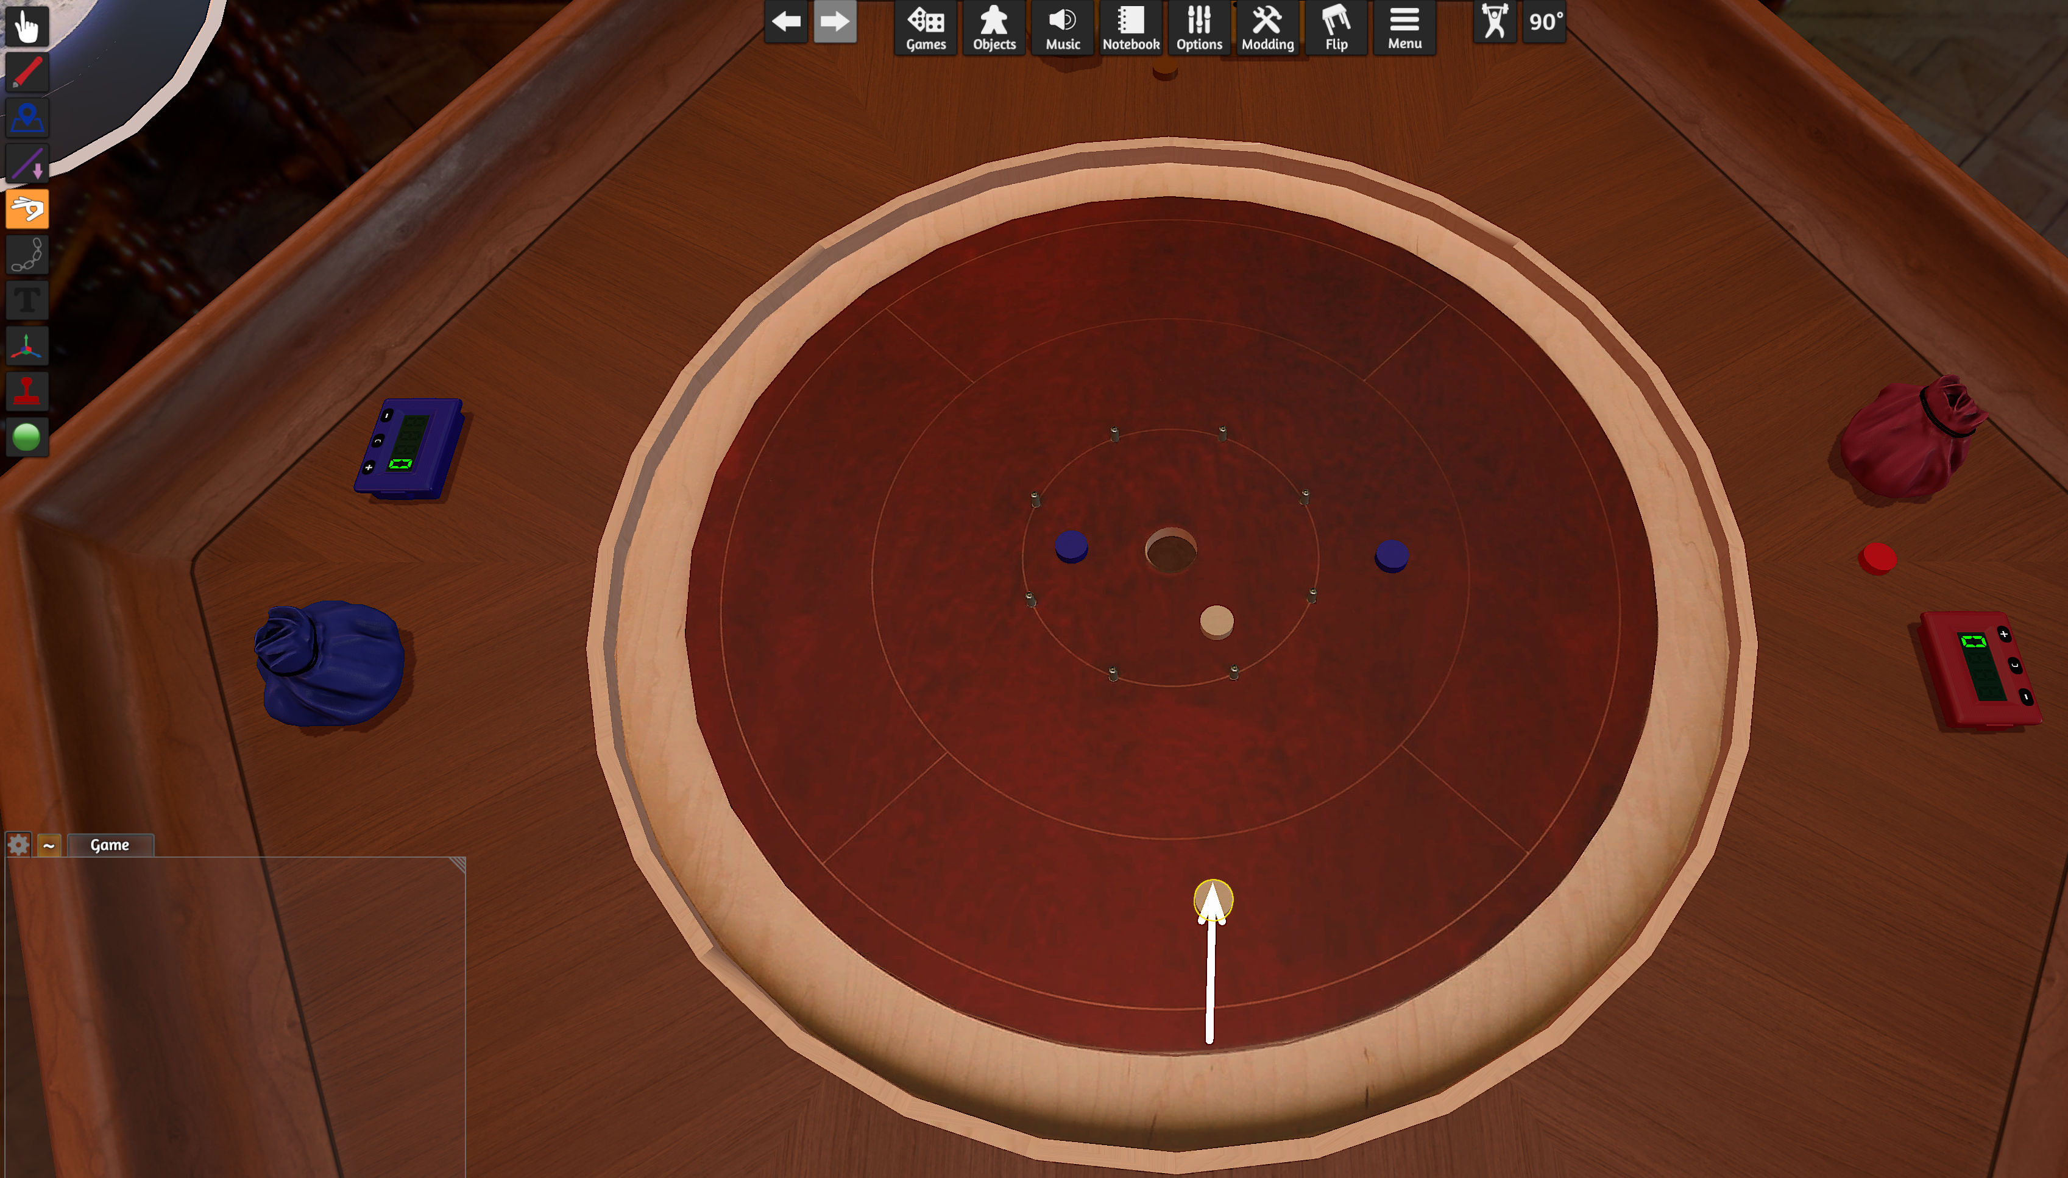
Digital boardgames
Notes:
Tabletop Simulator is a 3D ‘sandbox’ environment designed specifically to enable a realistic simulation of a board gaming experience. Game mechanics and rules are not enforced by the software, requiring players to move components around just as if playing on a real table. This allows great freedom in the types of games playable, but also requires the players to know - and manually implement - all game rules.
The intentionally generic nature of the gaming environment makes this software less suitable for some game types, especially some dexterity games. The physics engine within the game is functional, but the control scheme can be unintuitive. The platform serves reasonably well at simulating flicking type games such as Crokinole, but even simple stacking games such as Jenga are fiddly, and in some cases virtually impossible to play convincingly.

Slide 14
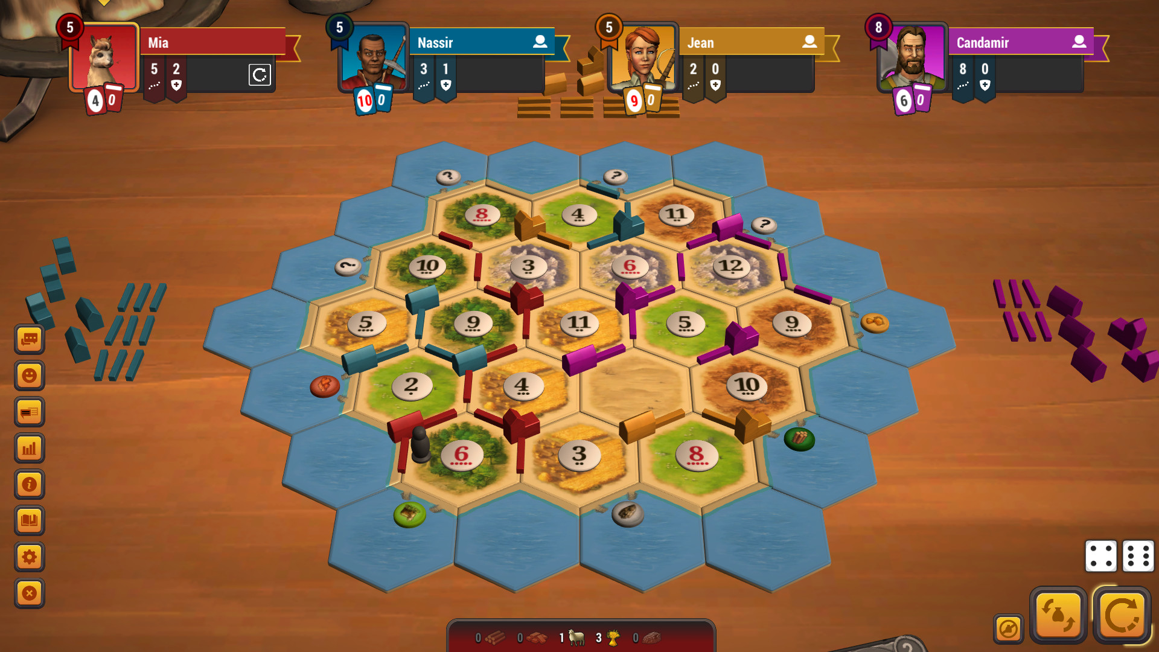
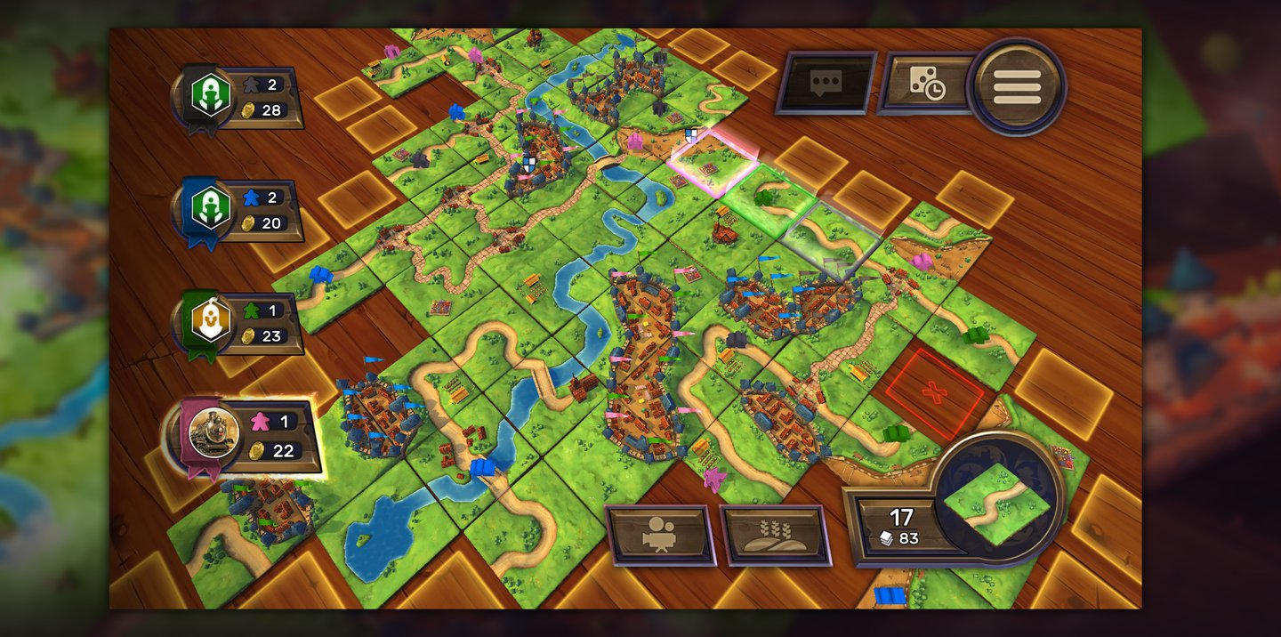
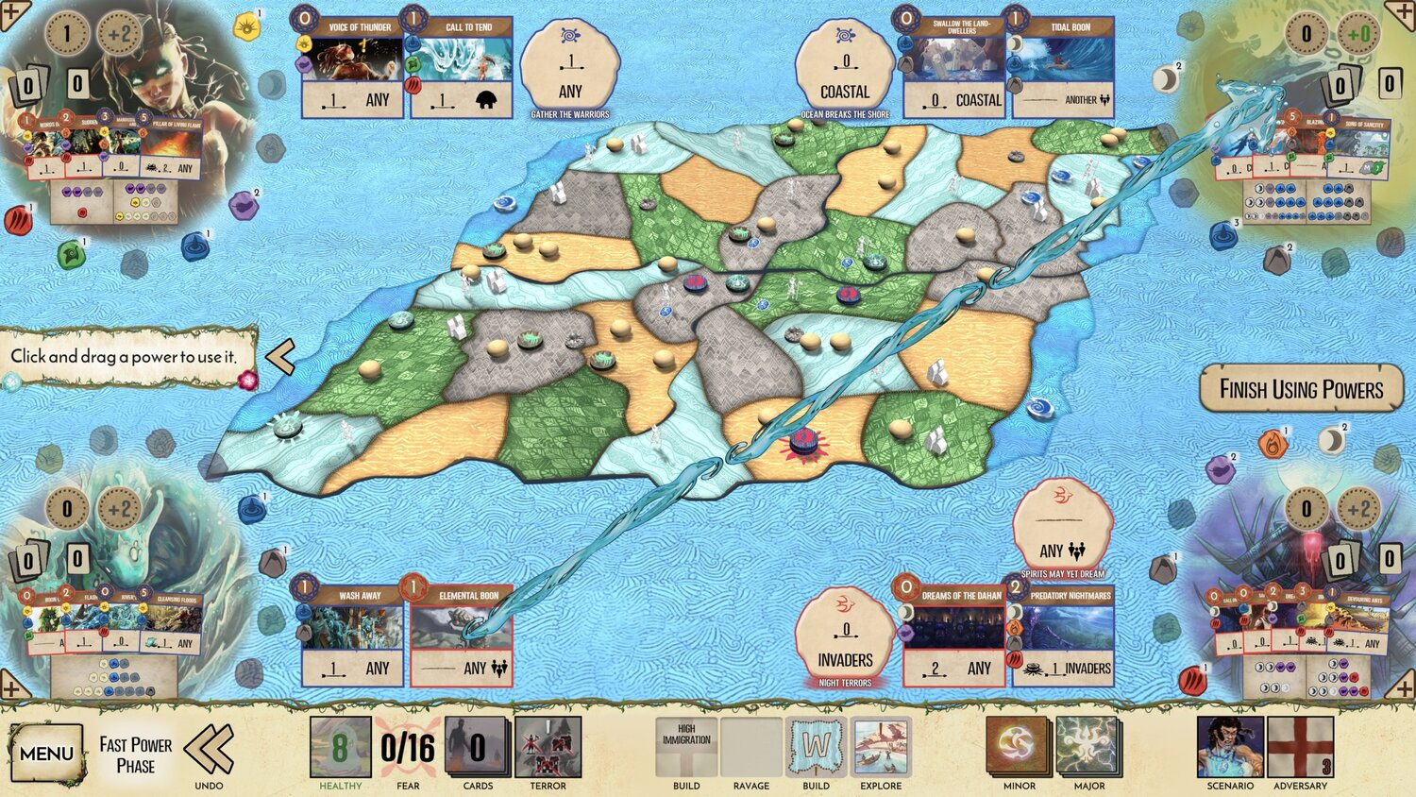
Digital boardgames
Kosmos: Catan Universe
PC, Android, iOS
Asmodee Digital: Carcasonne
PC, Android, iOS, Switch
Handelabra Games: Spirit Island Digital
PC, Android, iOS
Notes:
In addition to the general platforms, stand-alone digital versions exist of many of the more popular board games. Due to their singular focus, usually with the involvement of the original creators and publishers, these programs tend to be more polished playing experiences, with faithful reproduction of the physical assets and reliable implementation of the game mechanics. This focused implementation is a trait worthy of emulation, transferred to the genre of dexterity games, which are under-represented as stand-alone digital board game adaptations.

Slide 15
COVID-19
A. Lauer, “Virtual Board Gaming Is Your Unlikely Quarantine Savior,” Inside Hook, 30 03 2020. [Online]. Available: https://www.insidehook.com/culture/play-online-board-games-during-quarantine. [Accessed 21 10 2023].
E. St James, “The best way to play board games online,” Vox Media, 09 04 2020. [Online]. Available: https://www.vox.com/culture/2020/4/9/21214076/board-games-online-arena-internet-play. [Accessed 20 10 2023].
Berserk Games LLC, “The Future of Virtual Gaming One Year Later After Covid,” 19 03 2021. [Online]. Available: The Future of Virtual Gaming One Year Later After Covid. [Accessed 20 10 2023].
Board Game Arena, “Summer of Games 2023: a full month of daily releases!,” 31 07 2023. [Online]. Available: https://boardgamearena.com/news?f=10&t=31756&s=SUMMER+of+GAMES+2023%3A+a+full+month+of+daily+releases. [Accessed 22 10 2023].
Notes:
The increasing use of digital board gaming platforms in recent years was dramatically accelerated by the spread of the COVID-19 pandemic, and the attendant restrictions on social interactions. Online platforms reported dramatic spikes in users, especially in the spring of 2020. While opportunities for in-person gaming have largely returned to a normal state, the popularity of digital board-gaming has been maintained. New game adaptations are continuously being added to online platforms, and new stand-alone games continue to be published. There is a significant potential user-base for a product in this category.

Slide 16
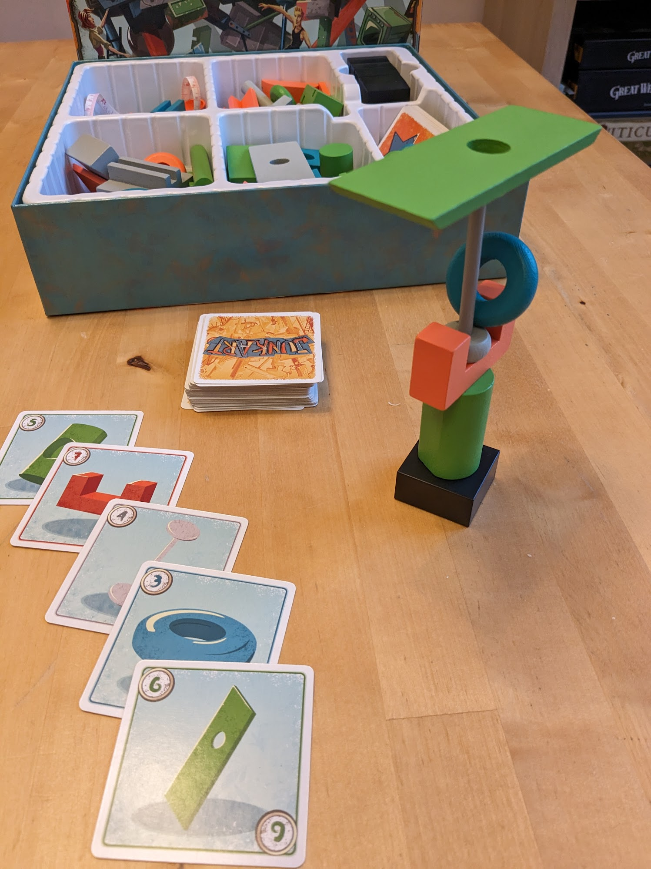
Junk Art
Physics simulation of stacking objects
Rules of game enforced
Automated scoring
‘Hotseat’ local multiplayer
Notes:
My proposal is to create a piece of software to simulate a single dexterity game, inspired by the physical game Junk Art - a game which revolves around the stacking of objects with unusual shapes. The software would include the physics of moving and stacking these objects, with an intuitive control scheme allowing players to move objects with six degrees of freedom. This is in contrast to the awkward interface for these types of games presented in Tabletop Simulator, and the lack of any such implementation in other generic board-game simulators.
The rules and scoring of the game would be automatically managed by the software, similar to how other single-game adaptations are designed.
Online multiplayer, while desirable, will likely be outside of the scope of this project due to the time and resources available. Local multiplayer via ‘hotseat’ or control-passing would be included.
Thank you for your time, and good luck to my fellow students with their own projects.

